Slide 1
Parkinson Disease Prediction
By :-
Vattikuti Manideep Sitaram
Guide :-
Dr. S. L. Jany Shabu

Slide 2
Presentation Outline
Coarse Certificate
Introduction
Objectives
Scope and Process
System Architecture/Architecture Diagram
System Requirements
Project Implementation Models
Work Snapshots
Result and Conclusion

Slide 3
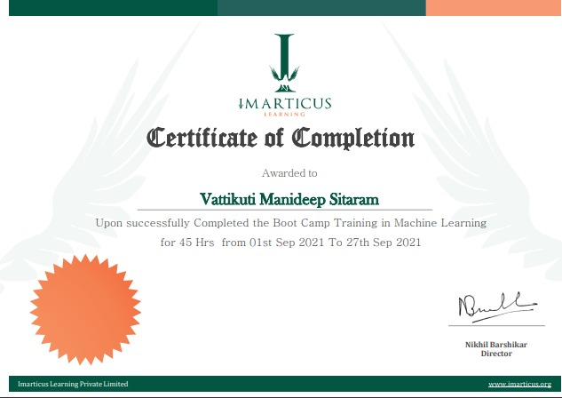
Coarse Certification

Slide 4
Introduction
Parkinson’s Disease is the second most prevalent neurodegenerative disorder after Alzheimer’s, affecting more than 10 million people worldwide
Parkinson's disease is a progressive nervous system disorder that affects movement
Symptoms start gradually, sometimes starting with a barely noticeable tremor in just one hand.
Parkinson’s is characterized primarily by the deterioration of motor and cognitive ability.
There is no single test which can be administered for diagnosis. Instead, doctors must perform a careful clinical analysis of the patient’s medical history.
Although Parkinson's disease can't be cured, medications might significantly improve your symptoms

Slide 5
Objective
To predict weather a person has parkinson disease or not
Depending upon the features that person provided the model predicts wheather the person needs medication or not
To equip the models with maximum efficiency and accuracy.

Slide 6
Scope and Process
This Project can be used to Predict Parkinson disease using data provided by user.
The Patients data has been taken from WHO along with features of listings and multiple Models has been trained on this data.
After gathering necessary data from user, it will be fed to trained models and used to predict weather a person has parkinson disease or not

Slide 7
System Architecture
Patient Details
Test dataset
Data Processing
Model
Train dataset
Classification ML Algorithm

Slide 8
Requirements
Software Requirements
Python 9 or above
SkLearn, Pandas, NumPy, seaborn.
Python IDE such as Jupyter Notebook, MS Visual Studio,…
Hardware Requirements
Any Capable Machine with above Software.

Slide 9
Project Implementation Models
Logistic Regression
Uses the sigmoid logistic equation with weights (coefficient values) and biases (constants) to model the probability of a certain class for binary classification
. An output of 1 represents one class, and an output of 0 represents the other.
Training the model will learn the optimal weights and biases
Decision Tree
Represented by a binary tree, where each root node represents an input variable and a split point, and each leaf node contains an output used to make a prediction

Slide 10
Project Implementation Models
k Nearest Neighbors
Makes predictions about the validation set using the entire training set. KNN makes a prediction about a new instance by searching through the entire set to find the k “closest” instances
“Closeness” is determined using a proximity measurement (Euclidean) across all features.
The class that the majority of the k closest instances belong to is the class that the model predicts the new instance to be.

Slide 11
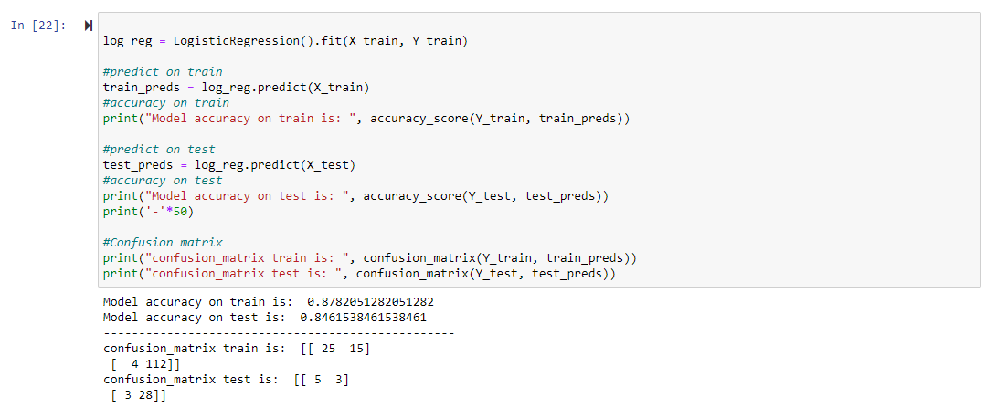
Work Snap Shots
Logistic Regression

Slide 12
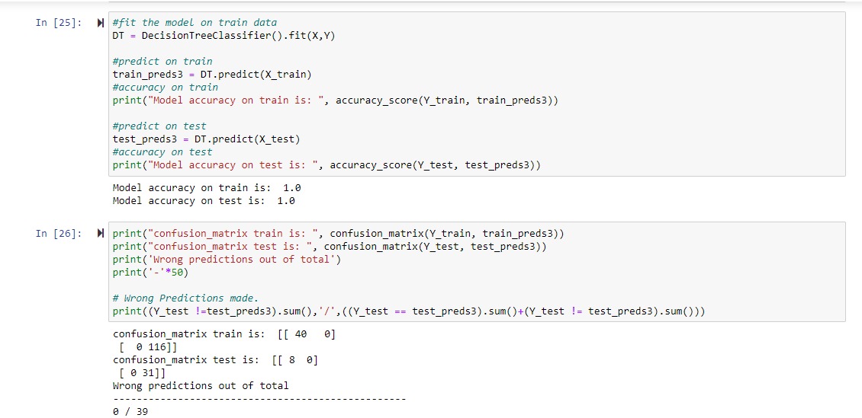
Work Snap Shots
Decision Tree

Slide 13
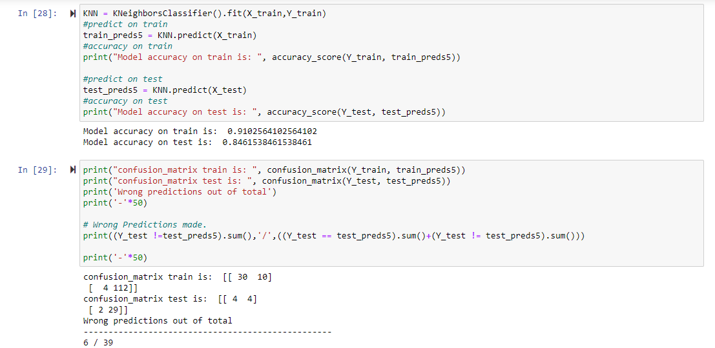
Work Snap Shots
K Nearest Neighbour

Slide 14
Result and Conclusion
These robust results suggest that a machine learning approach can indeed be implemented to significantly improve diagnosis methods of Parkinson’s disease.
Given the necessity of early diagnosis for effective treatment, machine learning models provide a very promising alternative to the current, rather ineffective method of diagnosis.
Logistic Regression gave around 88 percent accuracy whereas KNN gave 85 percent and Decision Tree gave around 100 percent accuracy
In Conclusion We can say that Decision Tree model performed well compared with other models and it is used to predict weather a person has parkinson disease or not

